Slide 1
Let’s Make Crazy Beautiful UI With Xamarin.Forms
David Ortinau
@davidortinau
Senior Program Manager, Xamarin Mobile SDKs

Slide 2
Themes: Colors, Fonts, Icons
Notes:
https://www.codeproject.com/Articles/1277945/Xamarin-Forms-Theming-Made-Simple

Slide 3
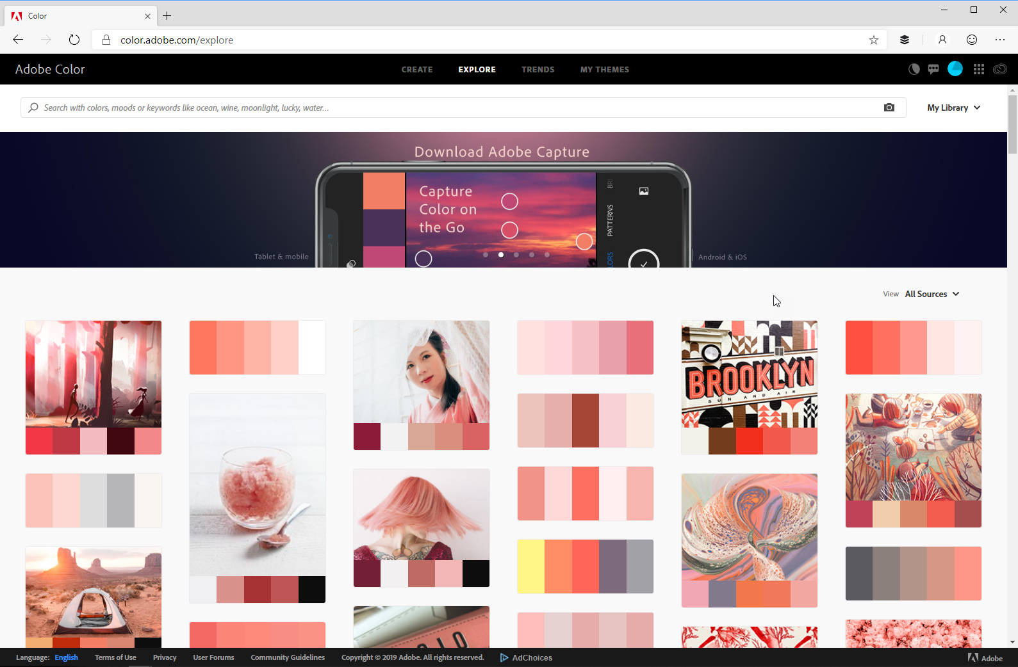

Slide 4
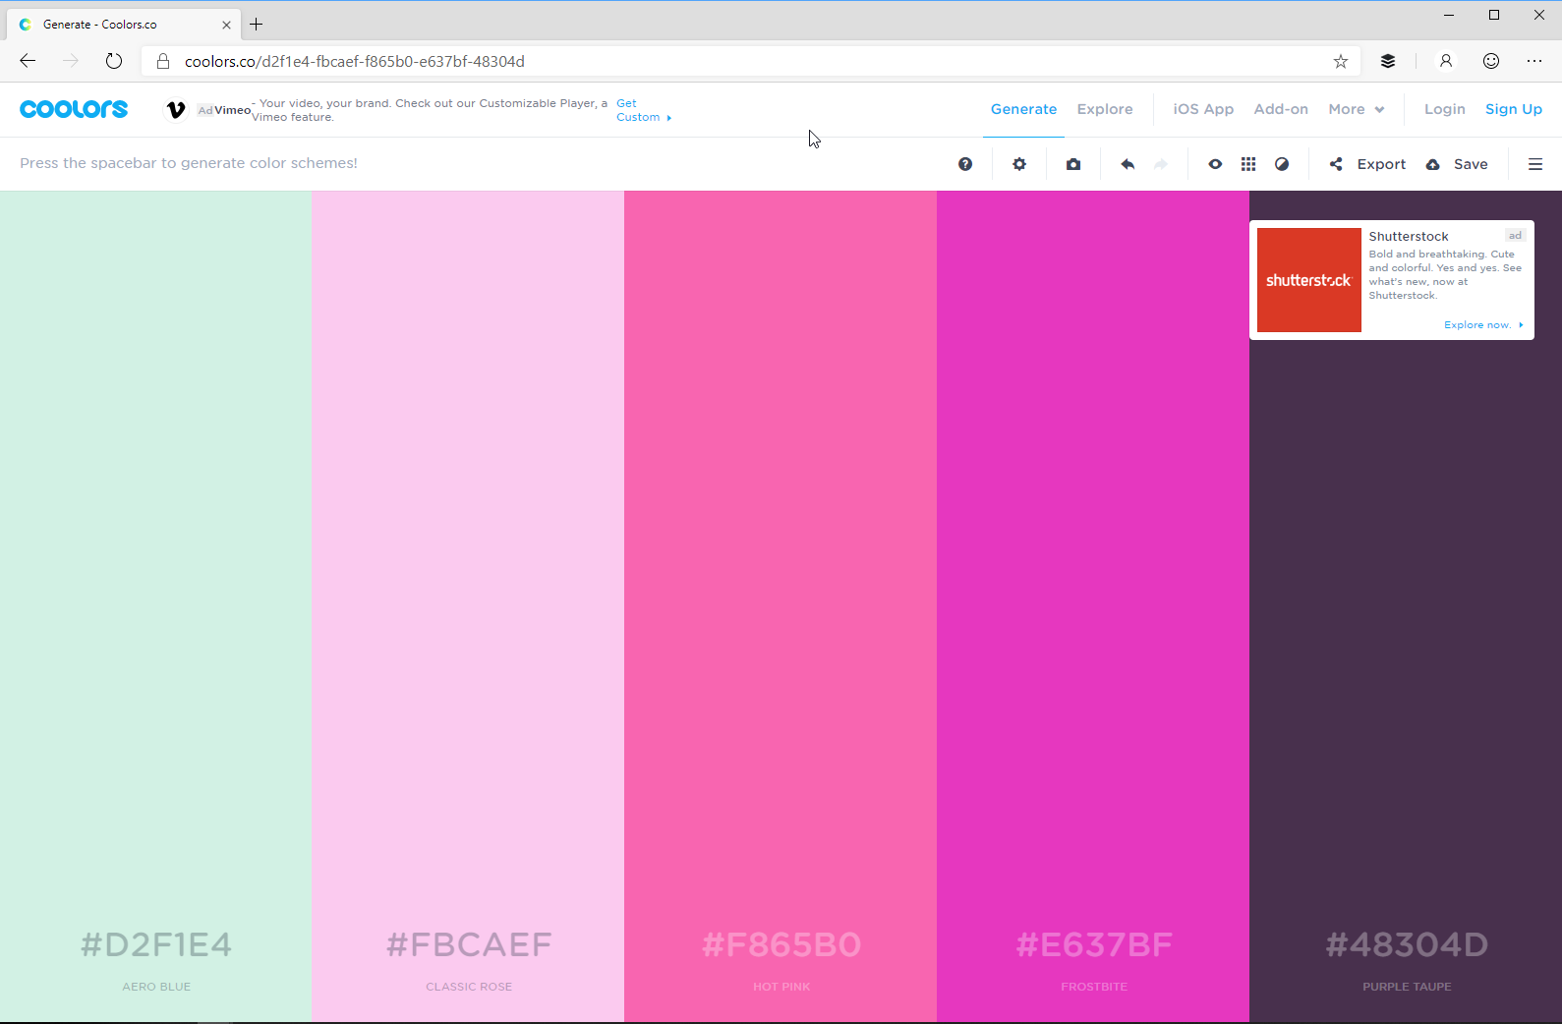

Slide 5
Options
Xamarin.Forms.Theme
Preview
Pain to setup
GrialKit
Super easy
Commercial
Write Your Own
Isn’t this why we are here?!

Slide 6
New Font Sizes for a11y
Member | iOS | Android | UWP
Default | 16 | 14 | 14
Micro | 11 | 10 | 15.667
Small | 13 | 14 | 18.667
Medium | 16 | 17 | 22.667
Large | 20 | 22 | 32
Body | 17 | 16 | 14
Header | 17 | 96 | 46
Title | 28 | 24 | 24
Subtitle | 22 | 16 | 20
Caption | 12 | 12 | 12
https://docs.microsoft.com/en-us/xamarin/xamarin-forms/user-interface/text/fonts#named-font-sizes

Slide 7
Ingredients
Theme Service
Preset Styles
Dynamic Styles applied to the UI

Slide 8
Theme Demo

Slide 9
Gradients & Shapes

Slide 10
How to Gradient
Native Code
SkiaSharp
PancakeView

Slide 11
How to Shape
Xamarin.Forms
Circle
Square / Rectangle
Bitmap image
Vector image
Drawn
SkiaSharp
Native Code

Slide 12
Gradients & Shapes Demo!

Slide 13
Taking over the Bars

Slide 14
Options
Custom Renderers
Plugins
https://www.sharpnado.com/pure-xamarin-forms-tabs/

Slide 15
Bar Demo!

Slide 16
Parallax

Slide 17
Layers
Feature Image
Scroll Content
Transparent NavBar
Opaque NavBar

Slide 18
Layers

Slide 19
Ingredients
ScrollPosition / ScrollPercentage
A value that is changing based on user input
Bindings
A way to apply the change to the secondary element
ValueConverter
A way to apply an offset to create the parallax effect
Optional: A min/max (start/end) to constrain the effect

Slide 20
(percentage * max) * factor;

Slide 21
Transitions

Slide 22
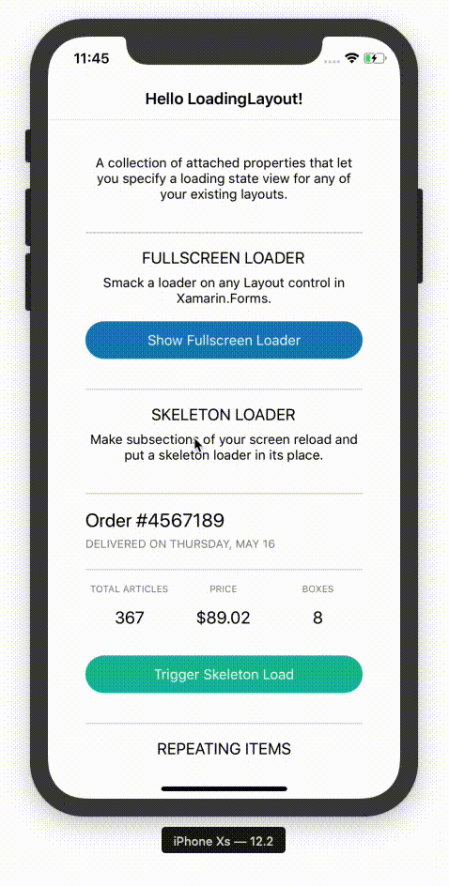

Slide 23
What makes a good Transition
Tell people SOMETHING is happening
Communicate WHAT is happening
Fill the time

Slide 24
When to use a Transition
Changing states
Updating data
Short running processes
Validation

Slide 25
Transition Guidelines
Do
Make it meaningful
Make it natural
Make it as brief as possible
Trigger it in response to a user action
Make it reversable
Don’t
Be gratuitous
Be a hindrance
Transition more than 1 thing or group of things at a time

Slide 26
Parallax & Transition Demo!

Slide 27
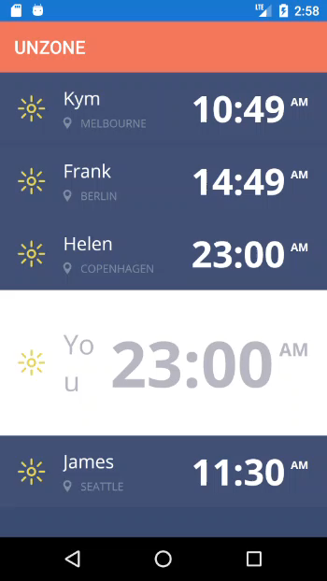
Kym Phillpotts
https://www.twitch.tv/kymphillpotts

Slide 28
Thanks!
Any Questions?
david.ortinau@microsoft.com
@davidortinau | twitch.tv/davidortinau

